Slide 1
Groupon Reviews Analysis
Students: Haitao Liu , Tianyu Liu, Jhaohan Chen, Lingyao Kong
Instructor: Rong Liu

Slide 2
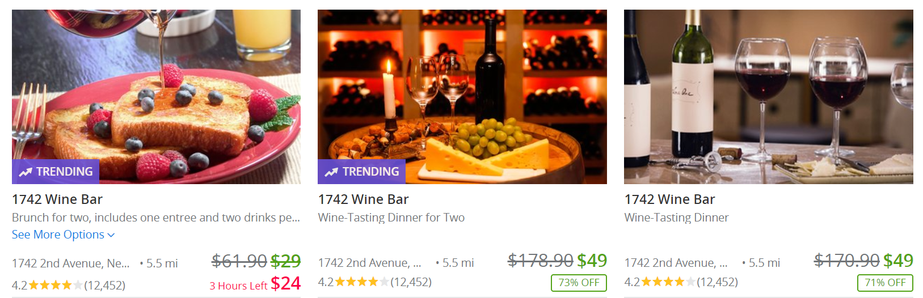
Introduction
What is Groupon?
Wine Bar
Advantage / Shortage
How to improve?
Datasets
Exploratory Data Analysis
Sentiment Analysis → Accuracy
Naïve Sentiment Analysis
Support Vector Machine
Convolutional Neural Network
Topic Modeling
Multi-labeled Classification
Result
Conclusion / Future work
SVM
CNN
Notes:
Groupon is the largest of the daily deals businesses: each day, in many markets, they offer Groupon, which deals providing a coupon for some products or services at a substantial discount.
a one-star increase led to a 59% increase in revenue of independent restaurants
There is a relationship include reviews, reputation, and revenue. According to this kind of relationship, we can figure out the Groupon effect, what is the hidden value of the review in order to understand the customers’ opinions, advantage and shortage of the restaurant, what aspects should the merchants’ improve?
Find the relation between the Rating score, Rating count and Reviews
Find the advantage and drawbacks for each wine bar in New York City according to their customers’ rating and reviews
Help the merchants have a better understanding of their bar and the aspects that need to be improved

Slide 3
Motivation
Unlock the hidden value of reviews in order to make better and more informed business decisions.
Fine tune the marketing strategy.
Gauge the effectiveness of the marketing campaigns

Slide 4
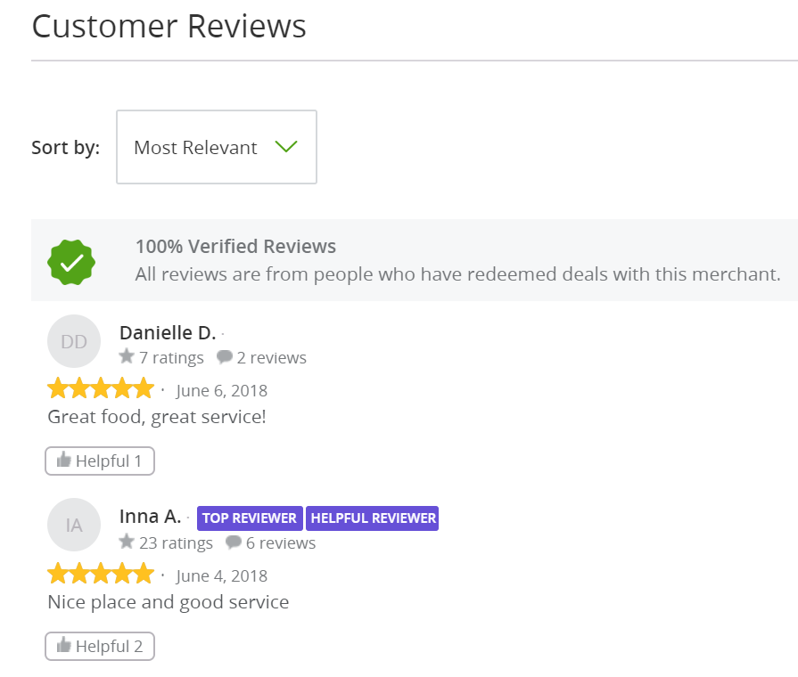
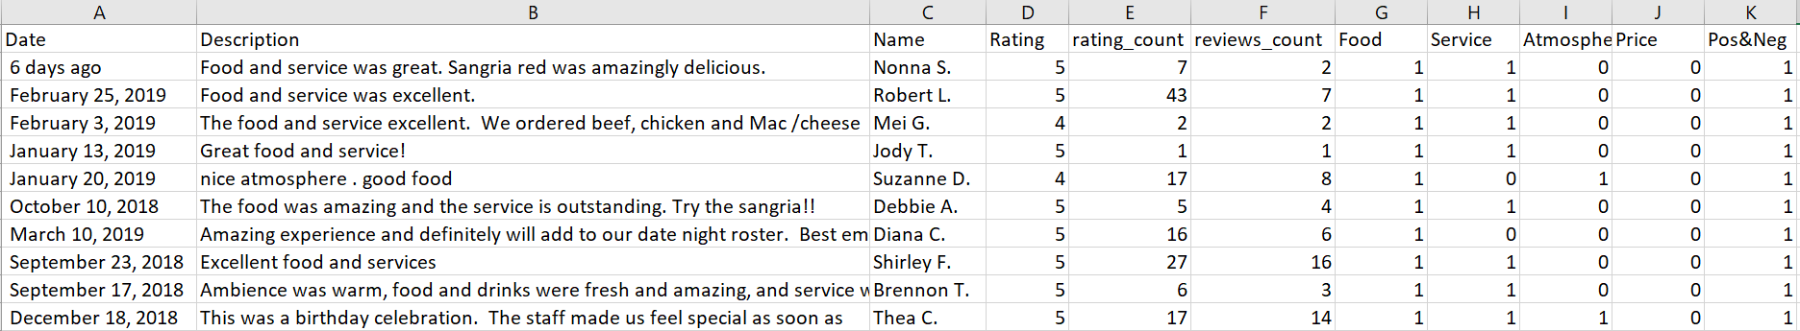
Dataset
Data Scraping & Cleaning
Python Selenium Webdriver
Store each wine bar in CSV file
30 Wine Bar / 9000 Reviews
Tokenization
Split sentences / words from the body of the text
Remove Punctuation / Stopword / Emoji
Labeled 1000 Reviews manually → Predict

Slide 5
Part of Speech Tagging:
We also tagged the part of speech in each review. From the list of POS tags, we use NN(noun, singular ‘desk’ ) and JJ (adjective ‘big’); then, we can find the specific aspects about the positive or negative reviews for different wine bar.
Example (any three wine bars):

Slide 6
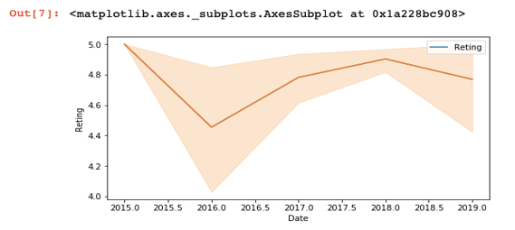
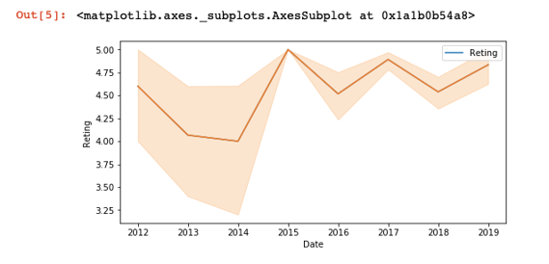
Exploratory Data Analysis
The tendency for each store's average rating by year
Choose two different wine bars to compare their tendency

Slide 7
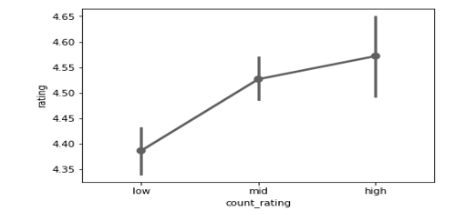
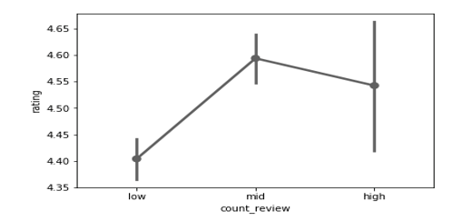
Exploratory Data Analysis
The relation between the number of ratings that each people has and rating values
The relation between the number of reviews that each people has and rating values

Slide 8
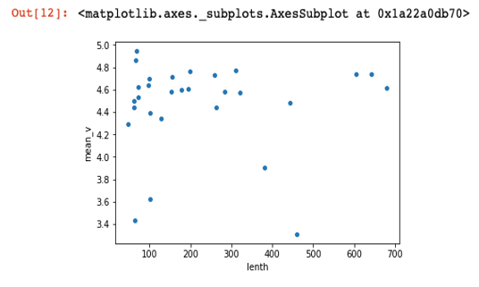
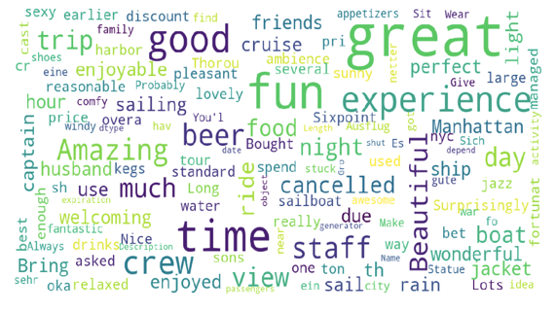
Exploratory Data Analysis
The relation between the number of rating and the rating value among those wine bars
What kind of words appear most in all reviews

Slide 9
Sentiment Analysis
Support Vector Machine
Naïve Sentiment Analysis
Convolutional Neural Network
LDA and Naïve Bayes
Topic Extraction
Convolutional Neural Network
Support Vector Machine

Slide 10
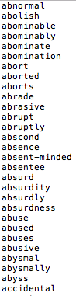
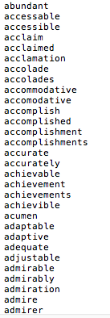



Naïve Sentiment Analysis
Two dictionaries including positive and negative words
Count the number of positive and negative words in a review
Positive words < Negative words
Positive words > Negative words
Positive words = Negative words

Slide 11
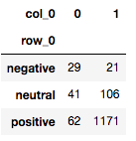
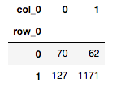
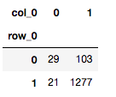
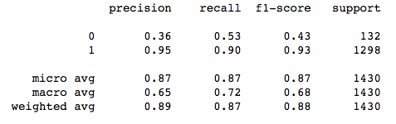
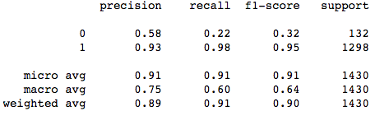
Naïve Sentiment Analysis
Assign the neutral sentiment to negative labels
Accuracy: 0.87
Confusion Matrix:
Performance:
Assign the neutral sentiment to positive labels
Accuracy : 0.91
Confusion Matrix:
Performance:

Slide 12
Support Vector Machine
5 fold cross validation:
The Average Accuracy: 0.86
Bias : class weight
0.5:30
TF-IDF, labels

Slide 13
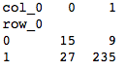
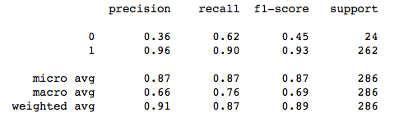
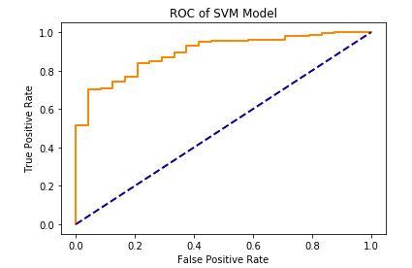
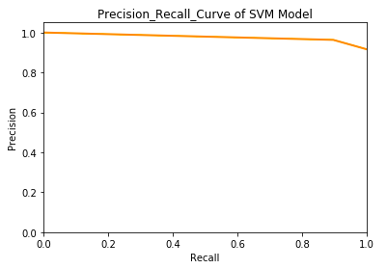
Support Vector Machine
Performance:
Confusion Matrix:
AUC:0.89

Slide 14
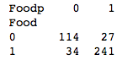
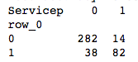
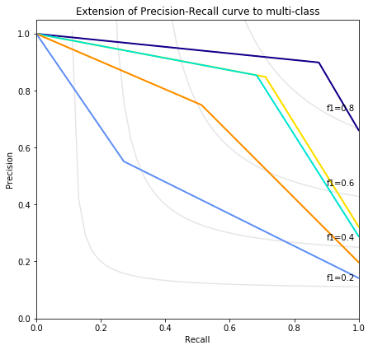
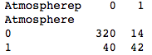
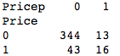
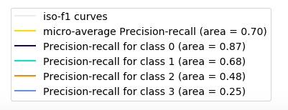
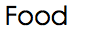
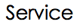
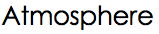
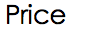
Multi-labeled Classification
Aspect: Food, Service, Atmosphere, Price
Method: SVM

Slide 15
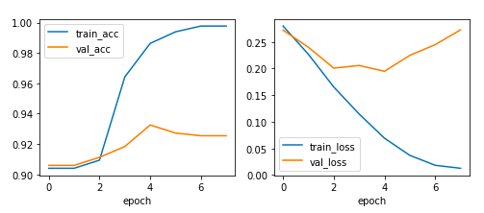
Convolutional Neural Network
Sentiment Analysis
Word2vectors(100*150)
Filters: unigram, bigram, Trigram
Convolution
Max pooling
Flatten
concatenate
Dropout :0.5
Dense
Use early stop to prevent the overfitting

Slide 16
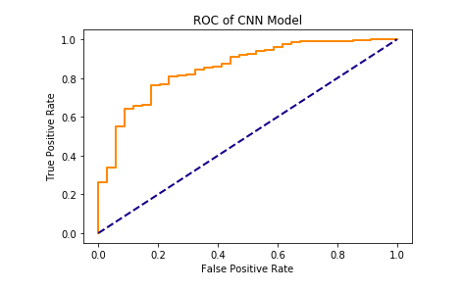
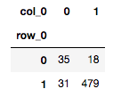
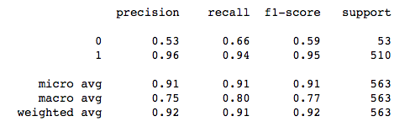
Convolutional Neural Network
Sentiment Analysis
Accuracy:92%
Confusion Matrix:
Performance:

Slide 17
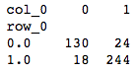
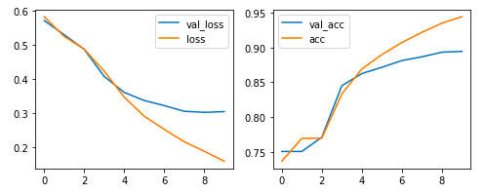
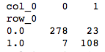
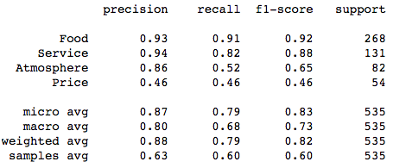
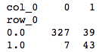
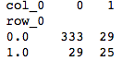
Convolutional Neural Network
Topic Extraction
Food 0.5
Service 0.5
Atmosphere 0.25
Price 0,15

Slide 18
Compare
Sentiment
Topic

Slide 19
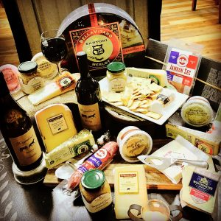
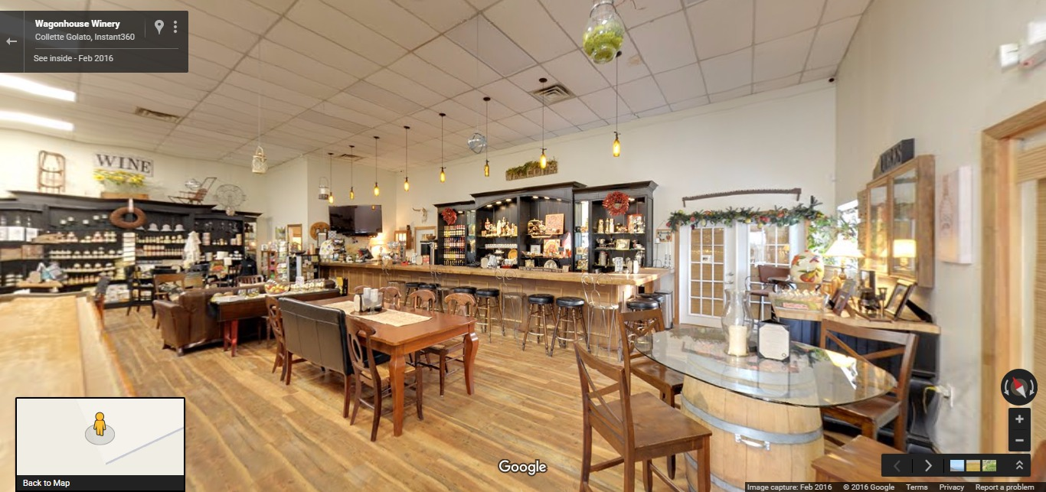
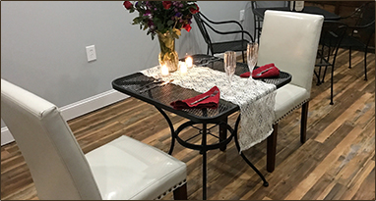
Result - Millbrook Winery

Slide 20
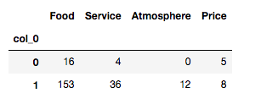
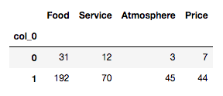
Result - Millbrook Winery
SVM
CNN

Slide 21
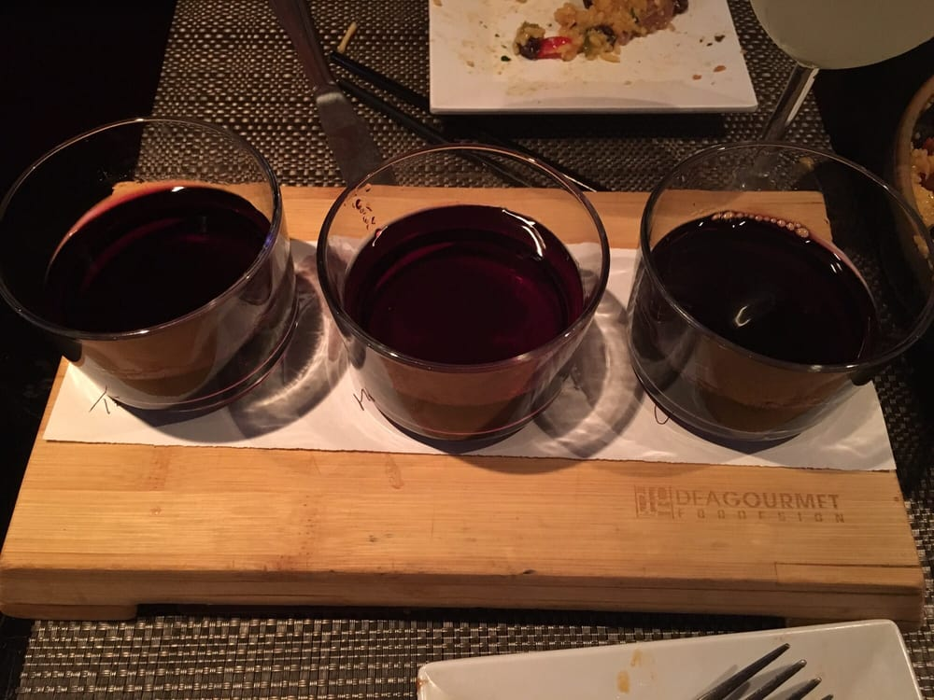
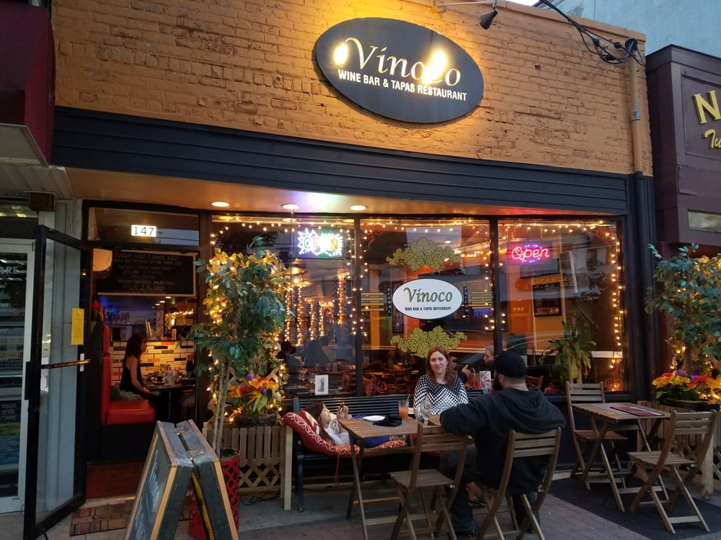
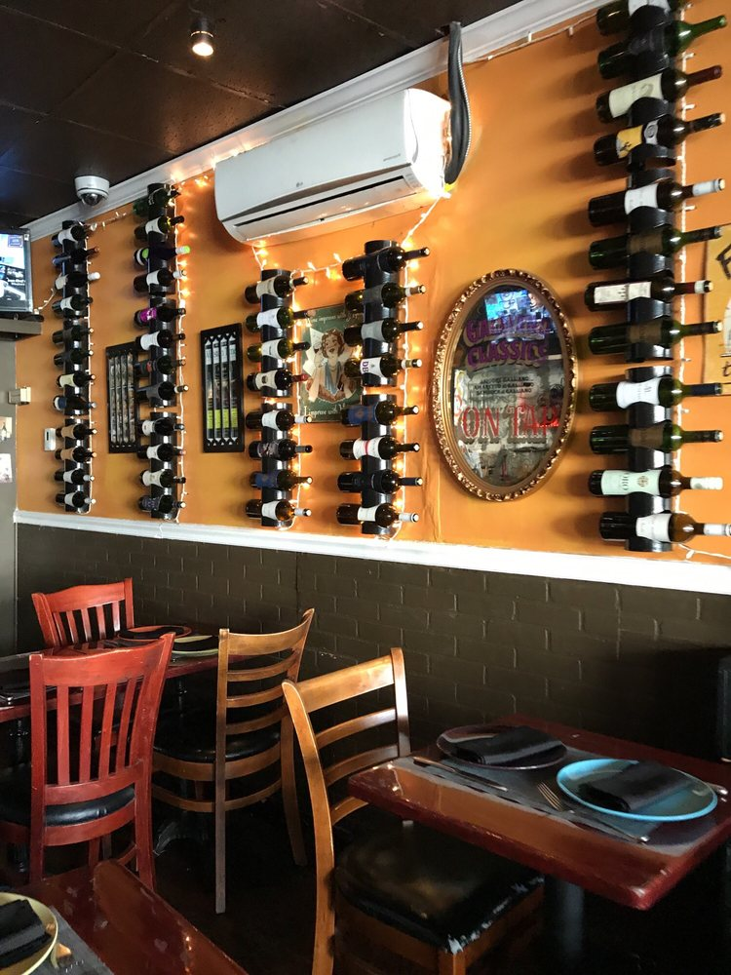
Result - Vinoco Wine Bar & Tapas Restaurant

Slide 22
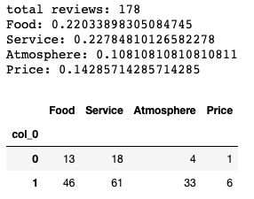
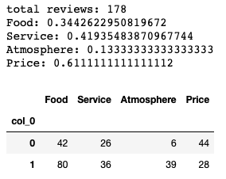
Result - Vinoco Wine Bar & Tapas Restaurant
SVM
CNN

Slide 23


Result

Slide 24
Future Work
Dependency parsing: find out the more specific content
Add more reviews that contain the price and atmosphere to improve the accuracy
Give the sentiment a score, not a 2-levels classification

